Slide 1
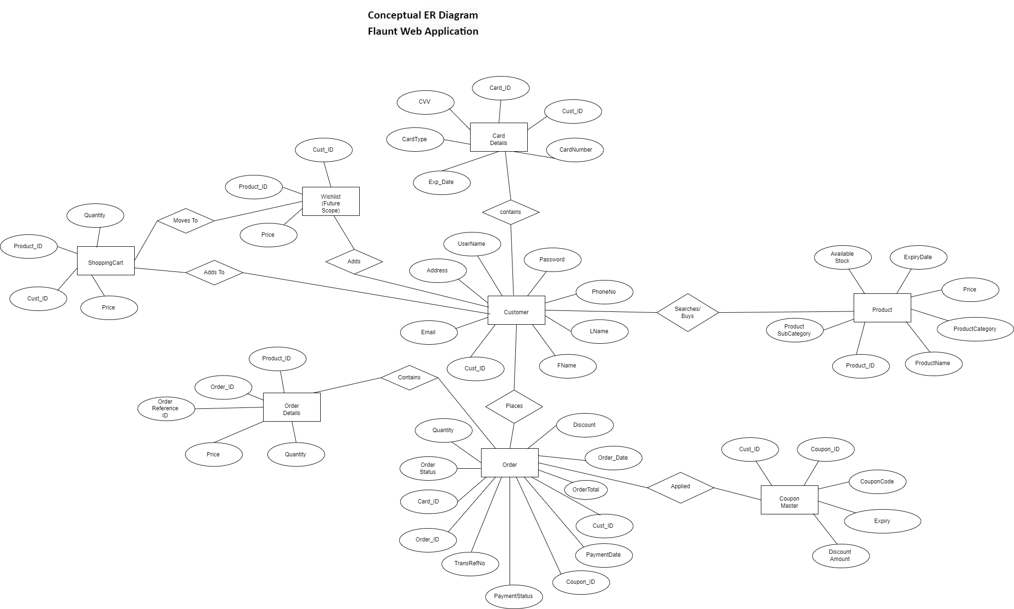

Slide 2
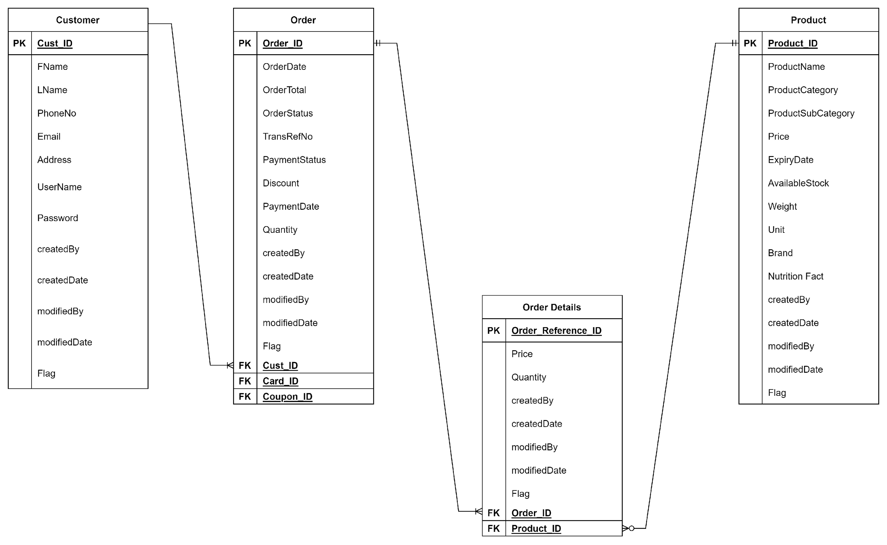
Logical ER Diagram - I1 Scope
Flaunt Web Application

Slide 3
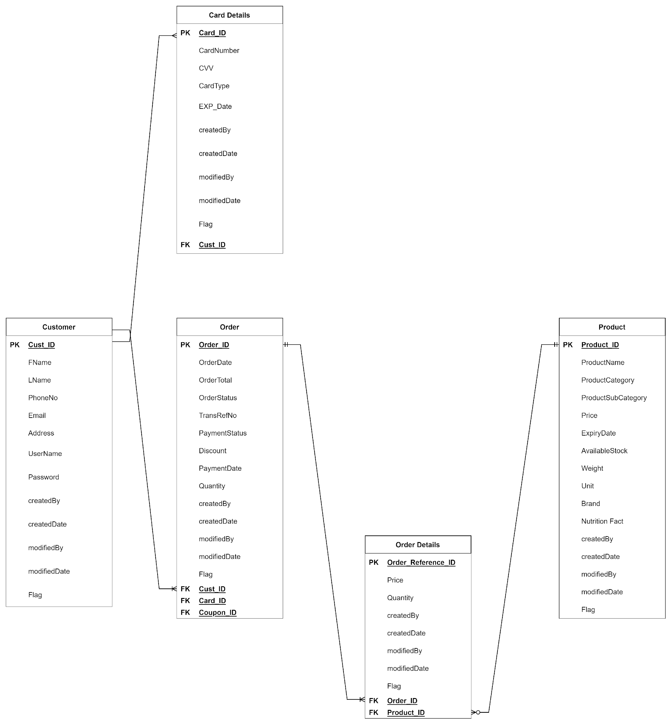
Logical ER Diagram – I2 Scope
Flaunt Web Application

Slide 4
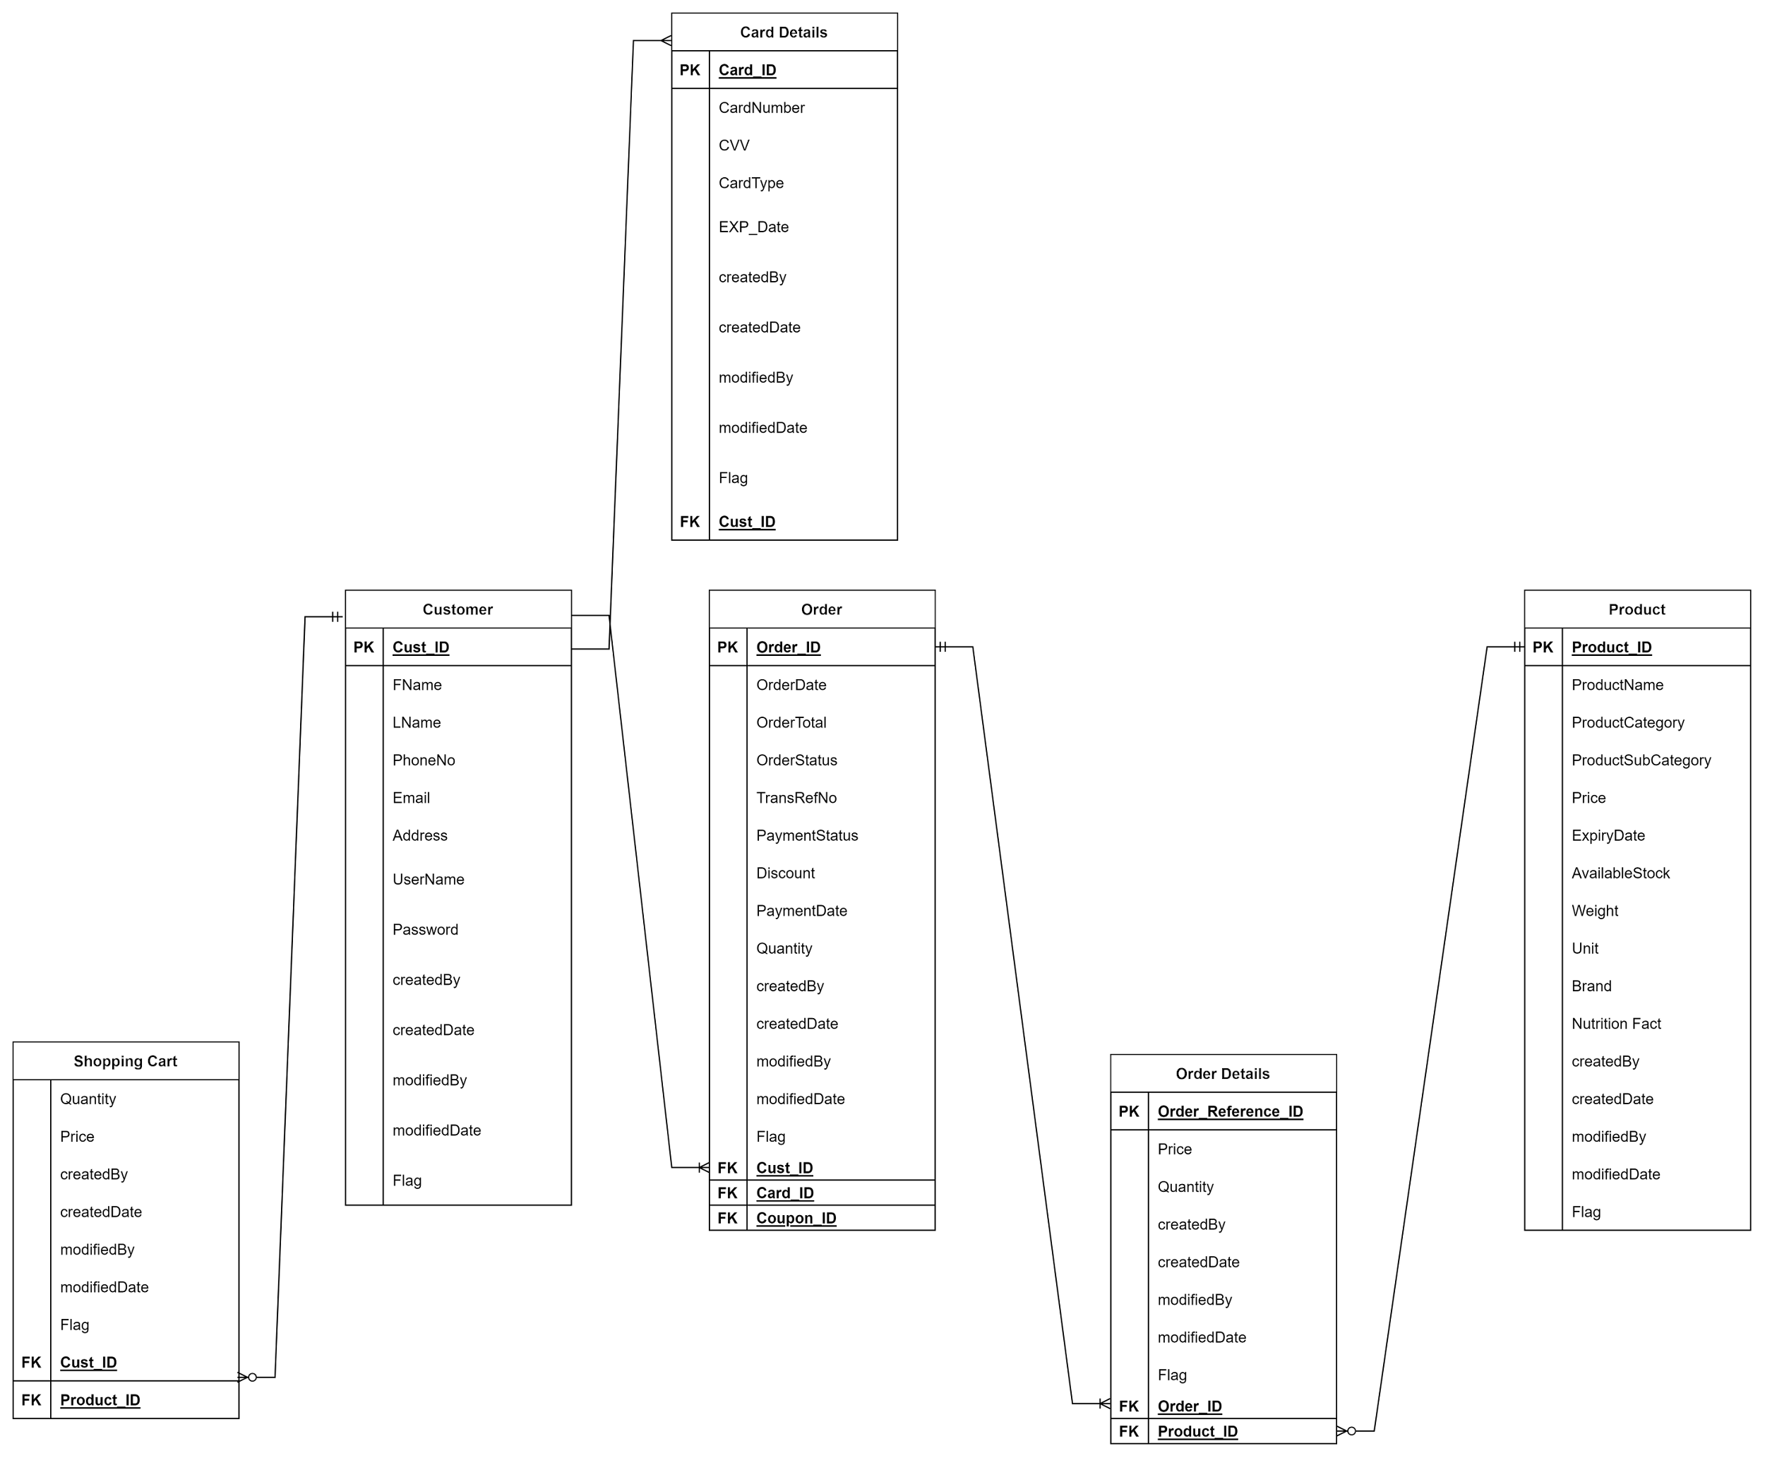
Logical ER Diagram – I3 Scope
Flaunt Web Application

Slide 5
Logical ER Diagram – I4 Scope
Flaunt Web Application

